Slide 1

MIST 6360 Introduction to Business Analytics
Week #2
Hugh J. Watson
Professor of MIS

Slide 2
What Is Meant by Analytics?
Data science involves the use of analytics
The analytics term is used differently and can refer to different things
#1 : A new term for BI (DSS → BI → Analytics)
#2 : Just the data analysis part of BI
Notes:
It is helpful to recognize that the analytics term is not used consistently; it is used in at least three different, yet related ways. A starting point for understanding analytics is to explore its roots. Decision support systems (DSS) in the 1970s were the first systems to support decision making [Power, 2007]. DSS came to be used as a description for an application and an academic discipline. Over time, additional decision support applications, such as executive information systems, online analytical processing (OLAP), and dashboards/scorecards, became popular. Then in the 1990s, Howard Dresner, an analyst at Gartner, popularized the business intelligence term. A typical definition is that “BI is a broad category of applications, technologies, and processes for gathering, storing, accessing, and analyzing data to help business users make better decisions.” With this definition, BI can be viewed as an umbrella term for all applications that support decision making, and this is how it is interpreted in industry and increasingly in academia. BI evolved from DSS, and one could argue that analytics evolved from BI (at least in terms of terminology). Thus, analytics is an umbrella term for data analysis applications. BI can also be viewed as “getting data in” (to a data mart or warehouse) and “getting data out” (analyzing the data that is stored). A second interpretation of analytics is that it is the “getting data out” part of BI. The third interpretation is that analytics is the use of “rocket science” algorithms (e.g., machine learning, neural networks) to analyze data. These different “takes” on analytics do not normally cause much confusion, because the context usually makes the meaning clear.

Slide 3
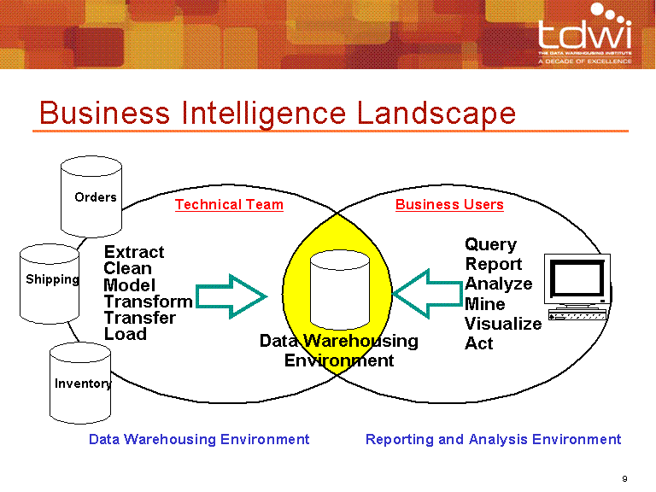
An Initial Reference Architecture
Notes:
For many organizations, data warehouses provide the “single version (or source) of the truth” for decision support data. The data is extracted from source systems (e.g., operational systems, ERPs), transformed (e.g., consistent formats), integrated (e.g., around a common key, such as a customer ID), and loaded into the data warehouse. The data can be thought of as “squeaky clean” because of the care taken to ensure its accuracy.
Users and applications access the data from the warehouse to support decision making.
A data warehouse involves getting data in and getting data out. The analysis of data is the getting data out part and can be considered to be analytics.

Slide 4
What Is Meant by Analytics?
Data science involves the use of analytics
The analytics term is used differently and can refer to different things
#1 : A new term for BI (DSS → BI → Analytics)
#2 : Just the data analysis part of BI
#3 : “Rocket science” algorithms (e.g., machine learning)
Notes:
People use the term differently but normally without creating problems.

Slide 5

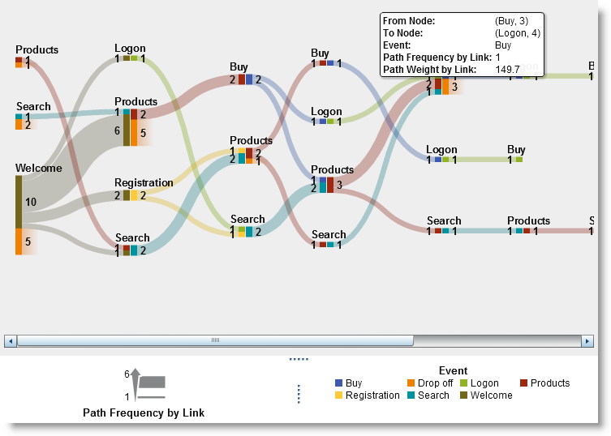
There are various kinds of analytics
Notes:
There are descriptive, predictive, and prescriptive analytics.

Slide 6
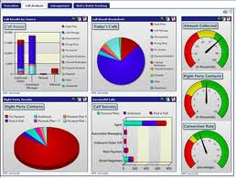
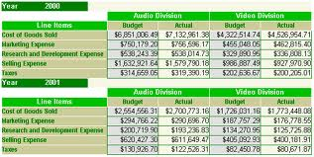
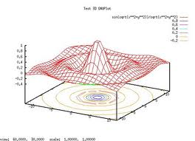
Descriptive Analytics
What has occurred?
Notes:
Descriptive analytics, such as reporting/OLAP, dashboards/scorecards, and data visualization, have been widely used for some time, and are the core applications of traditional BI. Descriptive analytics are backward looking (like a car’s rear view mirror) and reveal what has occurred. One trend, however, is to include the findings from predictive analytics, such as forecasts of future sales, on dashboards/scorecards.

Slide 7
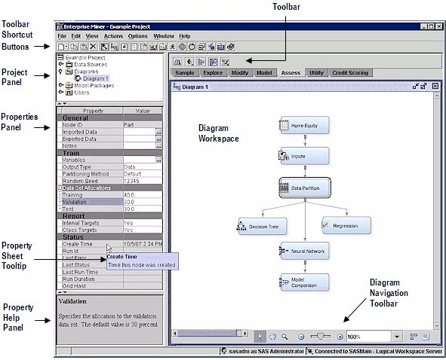
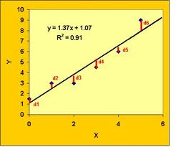
Predictive Analytics
The Data Science Sweet Spot
What will occur?
Notes:
Predictive analytics suggest what will occur in the future (like looking through a car’s windshield). The methods and algorithms for predictive analytics, such as regression analysis, machine learning, and neural networks, have existed for some time. Recently, however, software products (e.g., SAS Enterprise Miner) have made them much easier to understand and use. They have also been integrated into specific applications, such as for campaign management. Marketing is the target for many predictive analytics applications; here the goal is to better understand customers and their needs and preferences.

Slide 8
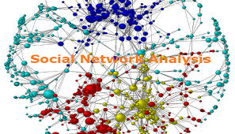
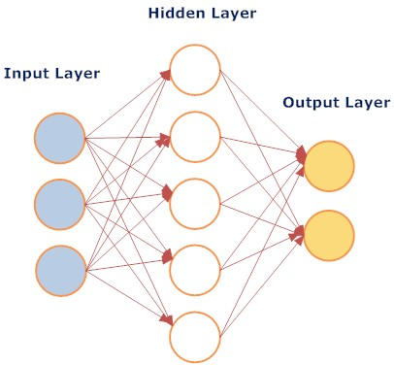
Discovery or Exploratory
Analytics
Predictive analytics with big data
Notes:
Some people also refer to exploratory or discovery analytics, although these are just other names for predictive analytics. When these terms are used, they normally refer to finding relationships in big data that were not previously known. The ability to analyze new data sources (i.e., big data) creates additional opportunities for insights and is especially important for firms with massive amounts of customer data.

Slide 9
Comparing Query/Reporting, BI, and Predictive Analytics
Query/Reporting | Business Intelligence | Predictive Analytics
Extraction of data; detailed or summaries | Summaries, analysis, and trends | Discovery of hidden patterns and predictions
Information | Analysis | Insight, knowledge, and prediction
Who purchased the product the past two quarters? | What is the average income of the buyers per quarter by sales region/ | Which customers are likely to buy a similar product in the future?

Slide 10
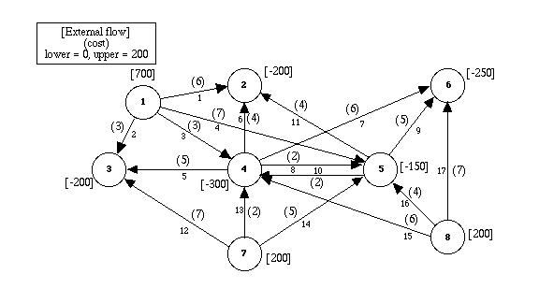
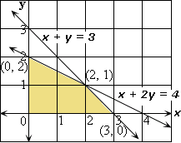
Prescriptive Analytics
What should occur?
Notes:
Whereas predictive analytics tells you what will happen, prescriptive analytics suggests what to do (like a car’s GPS instructions). Prescriptive analytics can identify optimal solutions, often for the allocation of scarce resources. It, too, has been researched in academia for a long time but is now finding wider use in practice. For example, the use of mathematical programming for revenue management is increasingly common for organizations that have “perishable” goods (e.g., rental cars, hotel rooms, airline seats). For example, Harrah’s Entertainment, a leader in the use of analytics, has been using revenue management for hotel room pricing for many years.
Organizations typically move from descriptive to predictive to prescriptive analytics. Another way of describing this progression is: what happened – why did it happen – what will happen – how can we make it happen? This progression is normally seen in various BI and analytics maturity models.

Slide 11

Descriptive
Predictive
Prescriptive

Slide 12
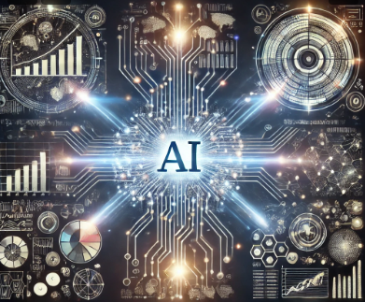
Descriptive
Predictive
Prescriptive

Slide 13

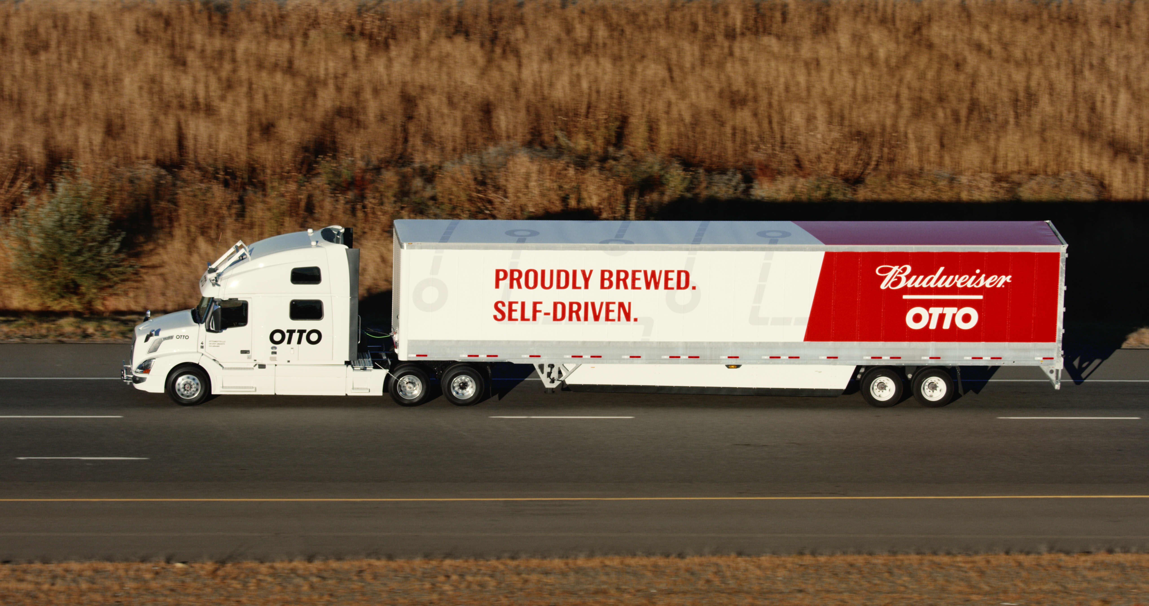
Famous AI Example of Autonomous Vehicles
Fort Collins to Denver
65 miles

Slide 14

A Combination of Skills Is Needed for Analytics Success
Success
Business Domain
Knowledge
Data
Skills
Modeling
Skills
Notes:
Any data science project requires business domain knowledge, data management, and modeling skills in or to be successful.

Slide 15

Business Domain
Business model
Strategies
Processes
Decisions
Communications
Data
Modeling
Access
Integration
Transformation
Preparation
Methods, techniques, and algorithms
Tools and products
Methodologies
Notes:
Each of the three required skills have component parts.

Slide 16
Domain
Knowledge
Data Management
Leadership
Modeling
UGA MSBA Competitive Advantage
Notes:
The analytics leader creates and communicates the vision for analytics; brings together the people, technology, and processes that are needed to realize the vision; and motivates people to achieve it. This person should have a minimum set of technical skills, but perhaps more important, this leader must possess the ability to partner with IT, analysts, and business leaders throughout the organization, including analysts in the business units, the BI group, data management, department heads, directors, senior managers, and executives. The analytics leader must have a finger on the pulse of the organization and understand the business problems and opportunities in order to be effective. A list of what successful analytics leaders do would include:
Aligning an analytics strategy with the business strategy
Translating business needs and opportunities into analytics initiatives
Creating an effective organization structure for analytics
Creating a skilled and effective team of analytics managers and professionals
Creating a strong analytics technical architecture
Ensuring strong analytics project management
Generating sponsorship for specific analytics projects and analytics in general
Maintaining ongoing communication with various stakeholders
Helping create a data-driven business culture
Ensuring that analytics creates measurable business value

Slide 17



A First Look at Analytics Users
Business User
Data Scientist
Business Analyst
Notes:
There are three categories of people to consider when discussing analytics – business users, business analysts, and data scientists. Each category requires different skills when it comes to analytics and uses analytics in different ways.

Slide 18
Business User
Accesses to analytics related information to perform their jobs
Notes:
The vast majority of our graduates will be business users who access analytics-related information and use descriptive analytics tools and applications in their work – reports, OLAP, dashboards/scorecards, and data visualization.

Slide 19
Business Domain
Data
Modeling
Business User
Notes:
Business users typically are strongest in terms of business domain knowledge – understanding their jobs and the business. But they also need to know what data is available, how to access it, and how to analyze it, at least in simple ways.

Slide 20
Business Analyst
Uses analytic applications to understand business conditions and improve business processes
May be in a centralized group or a business unit
Notes:
Business analysts use analytical tools and applications to understand business conditions and drive business processes. Their job is to access and analyze data, and to provide information to others in the organization. Most business analysts are located in the functional areas of business, such as marketing, and do analytical work, such as designing marketing campaigns, while others are in a centralized analytics team that provides analytics organization-wide. Depending on their position, business analysts work with some combination of descriptive and advanced analytics.

Slide 21
Business Domain
Business Analyst
Data
Modeling
Notes:
Business analysts should be analytical and inquisitive. Many are business school graduates, possibly with a MBA, but others have degrees in statistics, mathematics, engineering, or some other field where they gained analytical skills. If they are business school graduates, MIS, marketing, and finance are common majors.

Slide 22
Data Scientist
Uses interactive exploration tools and advanced algorithms and to uncover patterns and insights in data
Notes:
The data scientist title is taking hold, even though it sounds elitist . Data scientists have advanced training in multivariate statistics, artificial intelligence, machine learning, mathematical programming, and simulation to perform predictive and prescriptive analytics. They often hold advanced degrees, including PhDs in econometrics, statistics, mathematics, and management science. Companies don’t need a lot of them, but for some of the really advanced work, they come in very handy.

Slide 23

Business Domain
Data Scientist
Data
Modeling
Notes:
While business domain, data, and modeling skills are needed by business analysts and data scientists alike, their relative importance changes. For example, business analysts must have a high level of business domain knowledge while data scientists must be high in modeling skills. To make sure that all skills are present on a project, it is wise to have both business analysts and data scientists working on it.

Slide 24
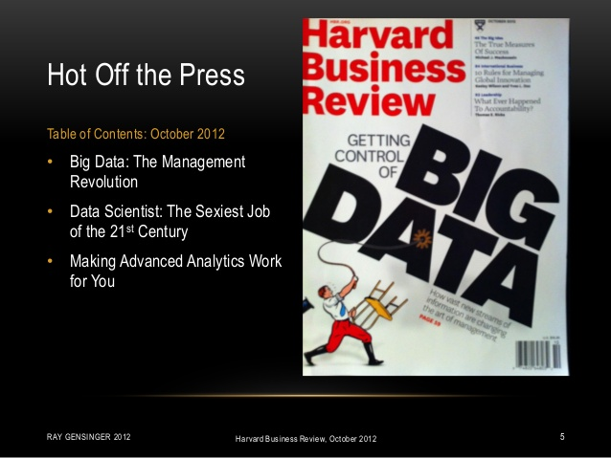
Notes:
Data scientist has been called “the sexiest job of the 21st century.”

Slide 25
The Most In-Demand Skill Today
“If you are looking for a career where your services will be in high demand, you should find something where you provide a scarce resource, complementary service to something that is getting ubiquitous and cheap. So, what’s complementary and cheap? Data. And what is complementary to data? Analysis. So, my recommendation is to take lots of courses about how to manipulate and analyze data.”
Hal Varian, Chief Economist at Google
Notes:
You are in the right field. But ultimately, you have to deliver business value.

Slide 26
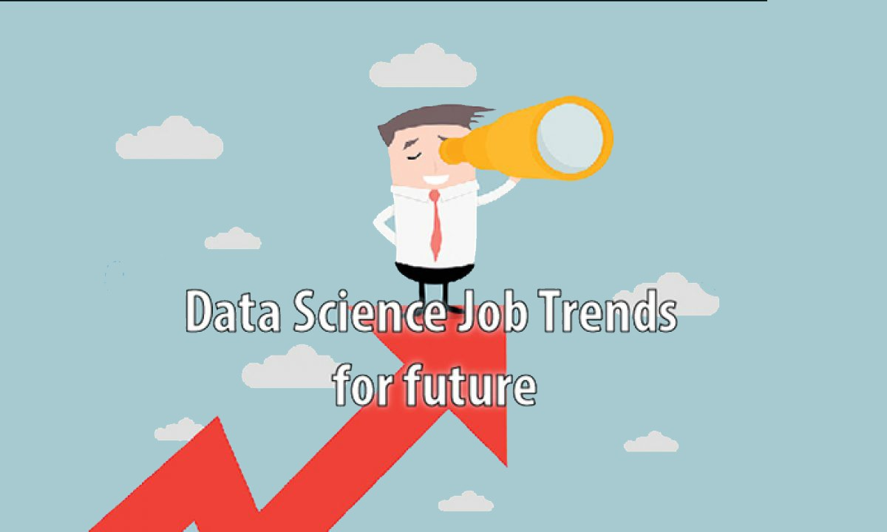
According to McKinsey Global Institute, by 2026, the demand for data scientists in the United States is predicted to exceed supply by over 50%
The U.S. Bureau of Labor Statistics projects a 36% growth in data scientist jobs between 2021 and 2031

Slide 27

Skills Required of Data Scientists
Curiosity
Intuition
Business domain knowledge
Data wrangling
Experimental design
Statistics
Programming skills
AI in general, generative AI in particular
Analytical tools and workbenches
Various models
Analytical development methodologies
Understanding of legal and ethical issues
Communication
Notes:
Data scientists are highly trained, skilled, and experienced professionals who discover new insights in data. The term “data scientist” is relatively new and is often attributed to D.J. Patil and Jeff Hammererbacher, who are in charge of data and analytics at LinkedIn and Facebook, respectively.
The job of data scientists is to discover patterns and relationships that no one else has seen or wondered about, and turn these discoveries into actionable information that creates value for the organization. To do this requires a rich mixture of skills. Data scientists need to understand the different types of data and how they can be stored (e.g., RDBMS, Hadoop), write code (e.g., Java, Python, R), access data (e.g., SQL, Hive), analyze it (e.g., regression analysis, social networks), and communicate findings to management in business terms (e.g., briefings, reports). Data scientists are typically very curious, like to solve difficult problems, and have advanced degrees (often PhD’s) in analytical fields, such as statistics, management science/operations research, computer science, and mathematics. Because of these requirements, data scientists are in short supply and command high salaries.

Slide 28
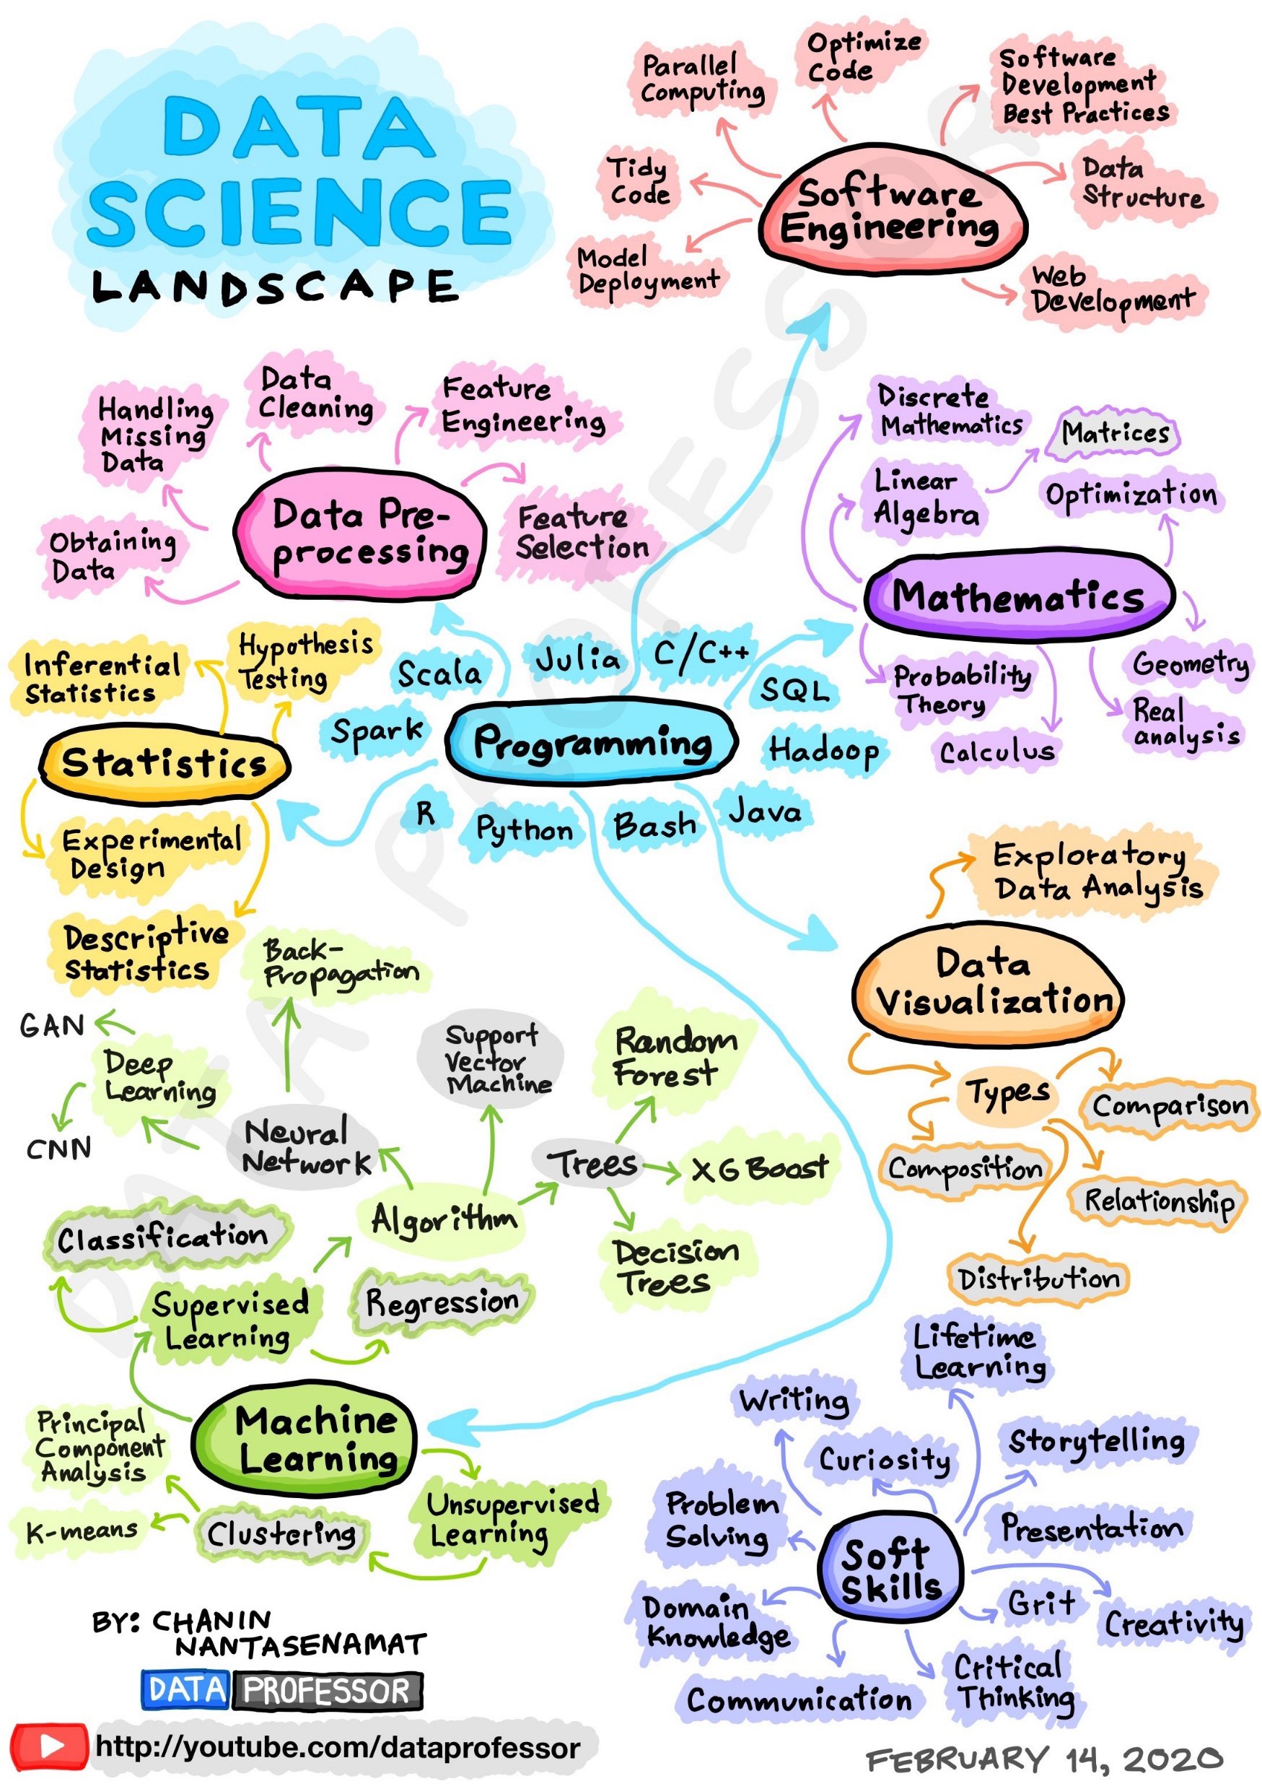
There is a lot to potentially learn

Slide 29

You don’t find many “full-stack data scientists”
Notes:
It is rare to find people who have all of the desired data scientist skills. Only purple unicorns are less common. As a result, teams of people are used in order to have the needed skill mix.
For companies that want to hire data scientists, there are creative ideas for how to proceed, including scanning the membership rolls of user groups dedicated to data science tools like R; looking for them on LinkedIn; engaging them at conferences like Strata, Structure:Data, and Hadoop World; and hosting a competition on Kaggle or TopCoder, the analytics and coding sites.

Slide 30
What Analytics Have You Performed at Work?
What Skills Were Needed?

Slide 31
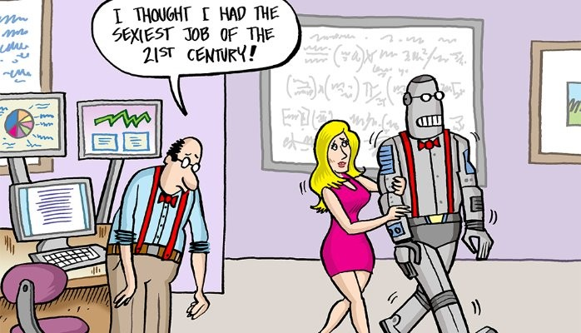
Additional Analytics Users and Professionals
Power end users
Power analysts
Citizen data scientists
Project managers
Data engineers
AI specialists

Slide 32
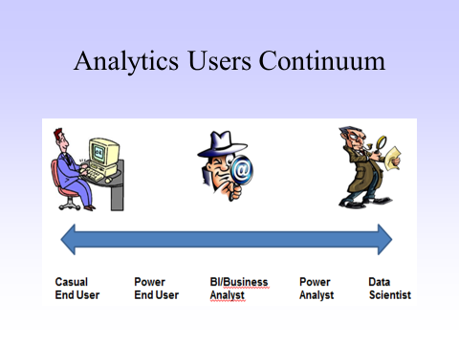
A More Granular Continuum
Notes:
This more granular continuum of analytics users includes power end users and power analysts.

Slide 33

Power End Users
Develops their own analytics applications
Helps other users with analytics
Notes:
Power end users are often experts with Excel and can create information using the company’s BI tool (such as MicroStrategy). Power users often answer questions for casual users, help them with analyses, and can build new reports for themselves and their colleagues. They have strong business skills and sufficient technical skill to access data, perform analyses, and create reports, dashboards, and scorecards.

Slide 34

Power Analysts
Further developed their skills in order to do advanced analytics
Notes:
Power business analysts know the business well and possess strong analytics skills. Because of the high demand for and limited supply of data scientists, some of these analysts have seized the opportunity to do data scientist-type work. They operate in a very specific domain, such as finance.

Slide 35

Citizen Data Scientists
Business people who are analytical, tech-savvy, inquisitive, and motivated to perform analytical work (when given the right tools and support)
Can help meet the need for analytics
Notes:
Power business analysts know the business well and possess strong analytics skills. Because of the high demand for and limited supply of data scientists, some of these analysts have seized the opportunity to do data scientist-type work. They operate in a very specific domain, such as finance.

Slide 36
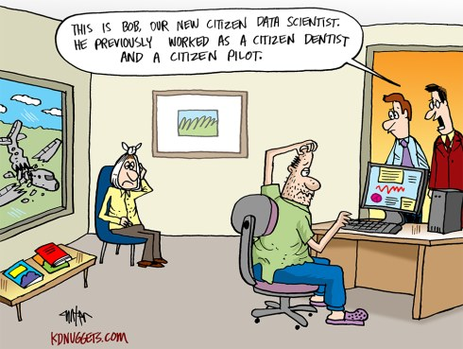
There are legitimate concerns about CDS, but …
CDS can make mistakes because the are not formally trained
CDS should follow a process for developing, certifying, and using models
CDS should be provided curated data
CDS should be given help when needed

Slide 37
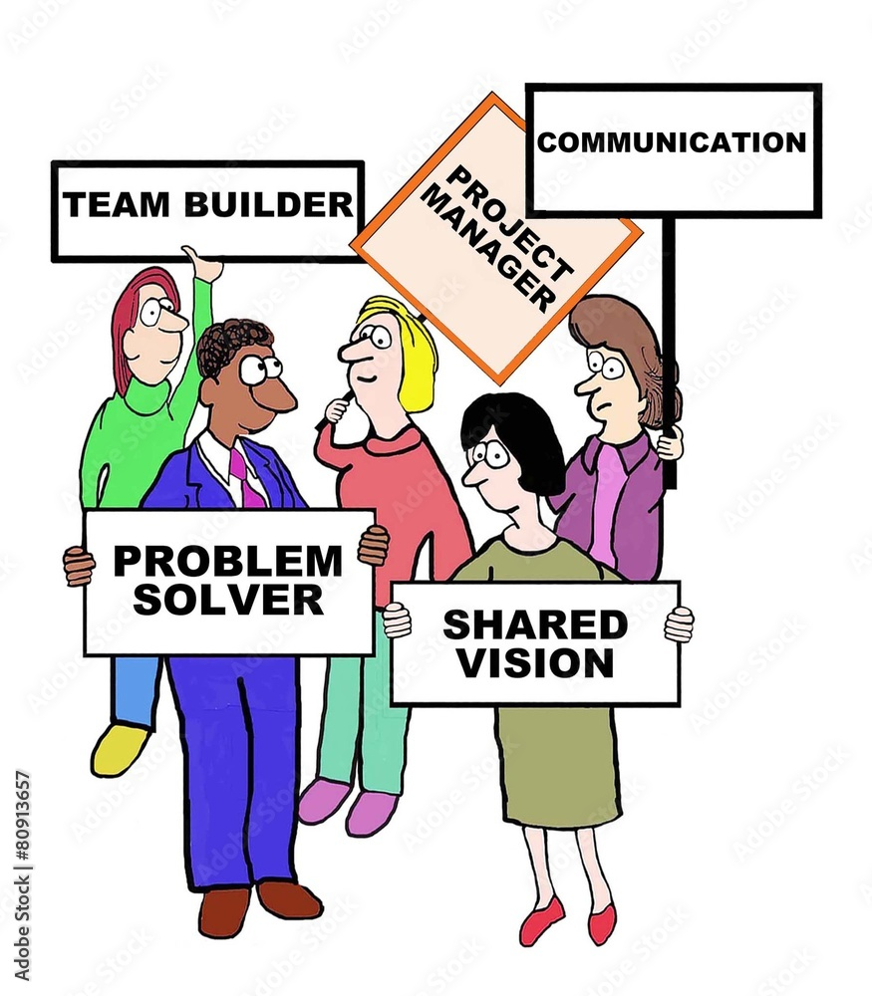
Analytics Project Managers
Oversee the project from approval to implementation
Develop the project plan (e.g., timelines)
Follow an appropriate agile methodology
Handle problems that arise
Make sure an application meets needs, is delivered on time, and on budget (i.e., The Golden Triangle of Project Success”)
Communicate with all stakeholders

Slide 38
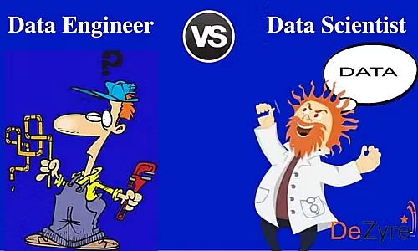
Data Engineers
Provide the data pipelines
Must be familiar with possible source systems
Must be able to extract data from source systems
Work closely with subject-area data base specialists
Currently in high demand

Slide 39

Application Developers
Take the model and turn it into an application
Must have strong technical and programming skills

Slide 40

Specialized AI Skills
Machine learning specialist
Large language model specialist
Model tuning specialist
Prompt engineer
Specialized AI skills -- natural language processing (NLP), vision systems, robotic process automation (RPA), chatbots, software agents, and virtual assistants
AI legal and ethics specialists

Slide 41

Organizing for Analytics
There isn’t a single best solution for all companies
It depends on
a company’s culture in regard to centralization/decentralization
where a company is in its analytics journey
departmental and company analytics needs

Slide 42
Alternative Models for Organizing for Analytics
Centralized – all of the analysts are located in a single organizational unit and perform analytical work throughout the organization

Slide 43
Alternative Models for Organizing for Analytics
Center of Excellence -- analysts are located and perform analytical work throughout the organization and the COE builds a community of analysts that share knowledge and best practices.

Slide 44
Alternative Models for Organizing for Analytics
Consulting -- analysts are in a central group and act as internal analytics consultants, who charge the business units for their services This consolidation of analysts provides some enterprise-wide coordination of analytical activities

Slide 45
Alternative Models for Organizing for Analytics
Functional -- analysts are located throughout the organization depending on business need. There is some sharing of knowledge and best practices

Slide 46
Alternative Models for Organizing for Analytics
Decentralized – analysts are hired and work in the business units as needed, and there is limited coordination of analytics activities throughout the organization

Slide 47
Alternative Models for Organizing for Analytics
Hybrid – analysts are in both a centralized unit and the business units. There is some sharing of knowledge and best practices. Becoming the norm in companies advanced in the use of analytics.

Slide 48

Centralized
Decentralized
The pros and cons of centralization versus decentralization are largely reversed
Advantages of centralization
A community of analysts who can share knowledge and best practices
Motive one another
Prioritize and organize the work to be done
Reduce duplication of effort
Standardize how work is done

Slide 49
Centralized
Decentralized
Disadvantages of centralization
Lack of business domain knowledge
A potential disconnect from business needs, realities, and priorities
A real or perceived belief by business unit managers that their analytical projects are not given sufficient priority and delivered in a timely manner
The pros and cons of centralization versus decentralization are largely reversed

Slide 50

Analytics Teams
Becoming common
Created to meet needs and seize analytics opportunities
Team members combine business, data, and analytics skills
May function like a start up
Work as a business partner with internal and external customers
Notes:
Many companies are creating teams to work on analytics projects. This is the case at Equifax.

Slide 51



Major Credit Bureaus
Services Provided
Credit Reports
Credit Scores
Custom Applications

Slide 52

The Solutions Delivery Team at Equifax
Works directly with customers on analytics applications
Team members have backgrounds in business, IT, data, and BI, and have access to data scientists
Helps customers use the Equifax analytics platform and build and configure applications
Notes:
At Equifax, here are over 500 Equifax team members world-wide that perform data and analytics-related work. For example, one team created a product called NeuroDecision™ that takes the “black box” out of neural networks through its capability for explaining a model’s logic. This capability is especially helpful in industries where government regulations place restrictions on the variables (e.g., age, gender) that can be used in decision making (e.g., credit). Another team focuses on quickly building custom solutions for customers (Equifax’s IGNITE™ Solutions).
Another team is Solutions Delivery. The team works directly with customers and is brought into potential analytics projects by Equifax’s relationship managers (i.e., sales representatives) and industry experts. The team supports both (1) customers who want to use Equifax’s analytical tools and data to build their own applications (Equifax IGNITE™ Direct), and (2) customers who need an existing Equifax application configured (e.g., select the available filters) to meet their needs (Equifax IGNITE™ Marketplace). All six team members have backgrounds that combine business, IT, data, and BI. A data scientist can be added to the team when advanced analytical skills are needed (e.g., predictive modeling).
Some of the first applications developed by the Solutions Delivery team were the result of requests from Equifax’s relationship managers who wanted information for meetings with potential clients. When the clients saw the applications, they wanted them for their own use. What was originally an in-house application became a product for customers. The movement from the use of data and analytics internally to external customers is consistent with a company’s maturity evolution journey.
There are some engagements where a customer is visited, a new application is discussed, and is built and delivered over night. The team believes in an innovate, “fail fast,” iterate, and “succeed quickly” approach. This fast success is possible because of the ability to go through many iterations in a short period of time with the customer. Because of their frequent interaction with customers and the freedom to act quickly, the team can quickly generate and deliver new applications. The team operates with much of the flexibility of a startup, but with the advantage of an exceptionally strong data and analytics tools infrastructure.

Slide 53

Auto Consumer Prospecting
Used by car dealers, banks, and credit unions
Predicts who is most likely to buy/get a car loan
Qualifies leads using different parameters – credit score, driving distance or time
Customized according to the customers’ needs and specs
Notes:
Banks, credit unions, and car dealerships have an interest in identifying people who are likely to buy a new car. In the case of banks and credit unions, this information can be used to target people for new car loans. Car dealerships can use it to identify people who are good candidates for buying a new car. Given a list of good candidates, marketing materials and offers can be designed and sent to the targeted set of potential buyers. Equifax’s Auto Consumer Prospecting application is designed for these B2B customers.
The application features a predictive model that calculates propensity-to buy scores and a highly visual interface that is appealing and easy-to-use by managers and marketing professionals. Some of the predictive variables used in the model are logical, such as whether the person has already bought a new car in the last six months, whether the person has applied for a car loan, and the potential buyer’s income. Other factors are less obvious. For example, when a person moves to a new neighborhood, there is a good chance that the person will buy a new car. What car the person buys is influenced by what cars the neighbors drive.

Slide 54
How Was the Company You Worked for Organized for Analytics?

Slide 55

Finding a Good Data Science Job
One study found that data scientists spent 1.5 hours a week looking at other jobs
What’s going on and what are the implications?

Slide 56

Why Data Scientists Change Jobs
The work doesn’t match expectations
The politics involved
Being the go-to person for anything involving data
Being on an isolated data science team
Notes:
By Jonny Brooks.
Vote in KDnuggets Poll inspired by this post:
Data Science / Machine Learning / Data Profession Job Satisfaction
Why so many data scientists are leaving their jobs
Yes, I am a data scientist and yes, you did read the title correctly, but someone had to say it. We read so many stories about data science being thesexiest job of the 21st century and the attractive sums of money that you can make as a data scientist that it can seem like the absolute dream job. Factor in that the field contains an abundance of highly skilled people geeking out to solve complex problems (yes it’s a positive thing to “geek out”), there is everything to love about the job.
But the truth is that data scientists typically “spend 1–2 hours a week looking for a new job” as stated in this article by the Financial Times. Furthermore, the article also states that “Machine learning specialists topped its list of developers who said they were looking for a new job, at 14.3 per cent. Data scientists were a close second, at 13.2 per cent.” These data were collected by Stack Overflow in their survey based on 64,000 developers.
I too have been in that position and have recently switched data science jobs myself.
So why are so many data scientists looking for new jobs?
Before I answer that question I should clarify that I am still a data scientist. On the whole, I love the job and I don’t want to discourage others from aspiring to be data scientists because it can be fun, stimulating and rewarding. The aim of this article is to play devil’s advocate and expose some of the negative aspects of the job.
From my perspective, here are 4 big reasons why I think many data scientists are dissatisfied with their jobs.
1. Expectation does not match reality
Expectation does not match reality
Big data is like teenage sex: everyone talks about it, nobody really knows how to do it, everyone thinks everyone else is doing it, so everyone claims they are doing it… — Dan Ariely
This quote is so apt. Many junior data scientists I know (this includes myself) wanted to get into data science because it was all about solving complex problems with cool new machine learning algorithms that make huge impact on a business. This was a chance to feel like the work we were doing was more important than anything we’ve done before. However, this is often not the case.
In my opinion, the fact that expectation does not match reality is the ultimate reason why many data scientists leave. There are many reasons for this and I can’t possibly come up with an exhaustive list but this post is essentially a list of some of the reasons that I encountered.
Every company is different so I can’t speak for them all, but many companies hire data scientists without a suitable infrastructure in place to start getting value out of AI. This contributes to the cold start problem in AI. Couple this with the fact that these companies fail to hire senior/experienced data practitioners before hiring juniors, you’ve now got a recipe for a disillusioned and unhappy relationship for both parties. The data scientist likely came in to write smart machine learning algorithms to drive insight but can’t do this because their first job is to sort out the data infrastructure and/or create analytic reports. In contrast, the company only wanted a chart that they could present in their board meeting each day. The company then get frustrated because they don’t see value being driven quickly enough and all of this leads to the data scientist being unhappy in their role.
Robert Chang gave a very insightful quote in his blog post giving advice to junior data scientists:
It’s important to evaluate how well our aspirations align with the critical path of the environment we are in. Find projects, teams, and companies whose critical path best aligned with yours.
This highlights the 2-way relationship between the employer and the data scientist. If the company isn’t in the right place or has goals aligned with that of the data scientist then it’ll only be a matter of time before the data scientist will find something else.
For those that are interested Samson Hu has a fantastic series on how the analytics team was built at Wish which I also found very insightful.
Another reason that data scientists are disillusioned is a similar reason to why I was disillusioned which academia: I believed that I would be able to make a huge impact on people everywhere, not just within the company. In reality, if the company’s core business is not machine learning (my previous employer is a media publishing company), it’s likely that the data science that you do is only going to provide small incremental gains. These can add up to something very significant or you may be lucky to stumble on a gold mine project but this is less common.
2. Politics reigns supreme
The issue of politics already has a brilliant article dedicated to it: The most difficult thing in data science: politics and I urge you to read it. The first few sentences from that article pretty much sum up what I want to say:
When I was waking up at 6 AM to study Support Vector Machines I thought: “This is really tough! But, hey, at least I will become very valuable for my future employer!”. If I could get the DeLorean, I would go back in time and call “Bulls**t!” on myself.
If you seriously think that knowing lots of machine learning algorithms will make you the most valuable data scientist then go back to my first point above: expectation does not match reality.
The truth is the people in the business with the most clout need to have a good perception of you. That may mean that you have to constantly do ad hoc work such as getting numbers from a database to give to the right people at the right time, doing simple projects just so that the right people have the right perception of you. I had to do this a lot in my previous place. As frustrating as it can feel, it was a necessary part of the job.
3) You’re the go to person about anything data
Following on from doing anything to please the right people, those very same people with all of the clout often don’t understand what is meant by “data scientist”. This means that you’ll be the analytics expert as well as the go-to reporting guy and let’s not forget that you’ll be the database expert too.
It isn’t just non-technical executives that make too many assumptions about your skills. Other colleagues in technology assume you know everything data related. You know your way around Spark, Hadoop, Hive, Pig, SQL, Neo4J, MySQL, Python, R, Scala, Tensorflow, A/B Testing, NLP, anything machine learning (and anything else data related that you can think of — BTW if you see a job specification with all of these written on it, stay well clear. It reeks of a job spec from a company that has no idea what their data strategy is and they’ll hire anyone because they think that hiring any data person will fix all of their data problems).
But it doesn’t stop there. Because you know all of this and you obviously have access to ALL of the data, you are expected to have the answers to ALL of the questions by……. well, it should’ve landed in the relevant person’s inbox 5 minutes ago.
Trying to tell everyone what you actually know and have control of can be hard. Not because anyone will actually think any less of you, but because as a junior data scientist with little industry experience you’ll worry that people will think less of you. This can be quite a difficult situation.
4) Working in an isolated team
When we see successful data products, we often see expertly designed user interfaces with intelligent capabilities and most importantly, a useful output which, at the very least, is perceived by the users to solve a pertinent problem. Now if a data scientist spends their time only learning how to write and execute machine learning algorithms, then they can only be a small (albeit necessary) part of a team that leads to the success of a project that produces a valuable product. This means that data science teams that work in isolation will struggle to provide value!
Despite this, many companies still have data science teams that come up with their own projects and write code to try and solve a problem. In some cases this can suffice. For example, if all that’s needed is a static spreadsheet that is produced once a quarter then it can provide some value. On the other hand, if the goal is to optimize provide intelligent suggestions in a bespoke website building product then this will involve many different skills which shouldn’t be expected for the vast majority of data scientists (only the true data science unicorn can solve this one). So if the project is taken on by an isolated data science team it is most likely to fail (or take a very long time because organizing isolated teams to work on collaborative project in large enterprises is not easy).
So to be an effective data scientist in industry it doesn’t suffice just to do well in Kaggle competitions and complete some online courses. It (un)fortunately (depending on which way you look at it) involves understanding how hierarchies and politics works in business. Finding a company that is aligned with your critical path should be a key goal when searching for a data science job that will satisfy your needs. However, you may still need to readjust your expectations of what to expect from a data science role.

Slide 57
The Takeaways
Not all data science work is solving cool problems
Be prepared to do a variety of work
Companies may not have a good understanding of data science
Companies may not have a good data science infrastructure
All jobs involve politics
Pick your company carefully based on your skills and interests
Notes:
It is important to recognize these truths as you enter the workplace in order not to be “that guy.”

Slide 58
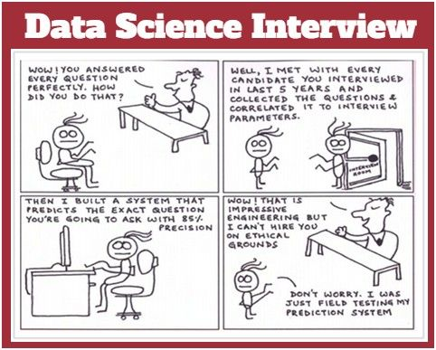
How to Recognize a Good Data Scientist Job From a Bad One
The job description correctly uses data science terminology
A hands-on test is part of the hiring process
There are concrete details instead of repetitive buzzwords
The company is open to you finishing current obligations before starting
The company mentions a data science team
The company is well-reviewed
Notes:
By Kayla Matthews, Productivity Bytes
When you're on the hunt for a fantastic data science job, finding one can be harder than it seems.
Alternatively, you may have the opposite problem and get the impression that all the data science opportunities seem far better than expected.
Job listings
In either case, some characteristics set good jobs apart from the bad ones. Here are six of them:
1. The Job Description Correctly Uses Data Science Terminology
Ideally, a data science job description should be specific and include language that indicates a familiarity with data science terms and the applications used for the work. If it's vague, you should worry that perhaps the company merely wants to hire a data scientist because they have the impression they should. In other words, since their competitors are hiring data scientists, they should follow suit.
If the job description doesn't include relevant data science terms and discuss the applications you'll use, the company may not have a well-defined purpose and role for the person they hire.
2. A Hands-on Test Is Part of the Hiring Process
It's increasingly common for companies hiring data scientists to have them take a data science project test. That means you'll demonstrate your skills in a scenario that may mimic the kind of work you'll do for the company. It's also possible the test will involve showing your coding skills. Data scientists use various programming languages, including R and Python, so you should be prepared to go through a coding assessment, too.
Conversely, if the job description has no mention of a test, that could mean the company isn't serious enough about hiring excellent and competent data scientists.
3. There Are Concrete Details Instead of Repetitive Buzzwords
Machine learning, artificial intelligence and the Internet of Things are a few examples of exciting emerging technologies that can double as mere buzzwords in a context without sufficient substance.
For example, you might come across a job posting for a company that gushes "We want to become the leading provider of artificial intelligence for the health care industry" and says "Our smart technology will help physicians embrace diagnosis tools powered by the Internet of Things" a few paragraphs later. It sounds great, but how will the company accomplish those goals?
If it doesn't go into detail about that, there's a good chance the enterprise is only leaning on those buzzwords like crutches and hopes that using them will make their openings sound more cutting-edge and exciting.
The company needs to give clear-cut information about how data science fits into its overall objectives, including clarifying the expectations set for any data science professional it hires. Otherwise, you may be looking at a hype-filled job description instead of one for a career that helps you grow and provide value to the company.
When businesses have data-centric goals, it's easy for them to conclude it's time to hire data scientists to do high-quality work on dedicated tasks. According to one survey, 69 percent of companies were in the process of building a people analytics database. A job ad for a good data science opportunity may mention you'd work on a specific project like that. Specificity about your duties helps increase a company's credibility.
4. The Company Is Open to You Finishing Current Obligations Before Starting
Maybe you're interviewing for a data science job 10 days before earning your degree, or you might work at a place where you haven't provided your two-week notice. In instances like those, a decent employer will allow you to tie up loose ends without feeling under pressure. However, if a company insists they need to hire you as soon as possible, that could be a red flag for several reasons.
First, the company may be rushing the hiring process, which could mean you get hired for a job that doesn't suit you. Second, they might not have thought through the position itself. In that case, you could enter a chaotic environment with little direction or leadership.
An arguably worse situation is if the employer tries to make you feel guilty for not starting immediately. They may even say something like, "Well, you're really leaving us in a bind, especially since the person you'd replace left so suddenly." Then you're left wondering why that person quit. Was it because they disliked the job?
5. The Company Mentions a Data Science Team
Numerous things, including a skills shortage and a growing use of technologies that generate data, drive the need to hire data scientists. However, some companies want to get into data science without having a relevant team first. You should always thoroughly research any company before going for an interview. Doing that often starts by going to the enterprise's website.
What you learn about the company will hopefully reveal that it has a data science team already — or at least one devoted to analytics. Also, the job description may bring up such a group, such as by saying you'll be leading it or meeting with members to work together on projects.
If nothing indicates the company has a data science or analytics team, think at length before accepting the offer. The lack of that essential point could mean data science is not a priority for the company, and they might expect you to do too much with inadequate or nonexistent resources.
If so, you could become so fed up that you end up leaving that job before getting to display your skills and be an asset to the company.
6. The Company Is Well-Reviewed
Part of your vetting process for any company offering you a data science position is to use employer review sites that allow current or former workers to give their opinions about the workplaces. A favorable job opportunity is likely linked with a company people give positive feedback about.
It's always possible that some disgruntled employees will weigh in about problems not related to the business or position. However, if you start to see negative feedback trends — such as people saying management doesn't listen to input from employees, the workload is too heavy, or the environment is extraordinarily stressful and doesn't allow a work-life balance — those are all warning signs.
Keep in mind that you may see some things as positive that others deem as downsides. For example, maybe someone worked as a data scientist for the company that offered you a job and said they had to do too much independent work. If you're a highly motivated person who doesn't require a lot of direction, that could be a plus for you.
Assess the Matter Thoroughly Before Deciding
Getting a job offer is typically an exciting milestone, and if it's the first one you've received as a data scientist, you could be exceptionally eager to take it.
However, it's crucial to be aware of the things on this list and realize that not all job offers are equal in the experiences and opportunities they provide.

Slide 59
Resources to Learn and Keep Up with the Data Science Field
KDNuggets at www.kdnuggets.com. Subscribe and receive a daily newsfeed of top stories, software, courses, employment opportunities, meetings, tutorials, and more
Eckerson Group at www.eckerson.com. Subscribe and receive articles on current topics, white papers, webinars, research reports, and more
Various AI emails and podcasts
Notes:
These are primary resources that I use and recommend that you do the same.

